Slide 1
4th Sunoikisis DC common session Irine Darchia, Levan Gordeziani Colonies and politics 28 April 2015

Slide 2
Thucydides 1.1.
Thucydides, an Athenian, wrote the history of the war between the Peloponnesians and the Athenians, beginning at the moment that it broke out, and believing that it would be a great war, and more worthy of relation than any that had preceded it… the rest of the Hellenic race taking sides in the quarrel; those who delayed doing so at once having it in contemplation… (Translation of Richard Crawley, The Landmark of Thucydides)

Slide 3
πόλις – polis
The usual translation is city,
traditional interpretation – city-state,
but it is neither a city – most of them had no urban centres at all, nor a state in the modern sence, rather something like a joint-stock company where shareholders were πολίται – citizens.

Slide 4
πόλις – polis
The designation of the people appears often as a name of an acting political unit, not the name of a city or land: Athenians, Peloponnesians, etc.
According to the context, πόλις could be translated as land, city, people and only in very few cases as state.
The modern sence of state is often expressed by other terms, for ex.:
ἀρχή (2.36) – power, empire
πολιτεία (2.37) – political system, constitution

Slide 5
Early Kingdoms as Polis
1.4. He (Minos) made himself master of what is now called the Hellenic sea, and ruled over the Cyclades, into most of which he sent the first colonies (lit.: was the first colonizator – οἰκιστὴς πρῶτος), expelling the Carians and appointing his own sons governors; and thus he did his best to put down piracy in those waters, a necessary step to secure revenues for his own use.

Slide 6
Early Kingdoms as Polis
1.8. But as soon as Minos had formed his navy, communication by sea became easier, as he colonized most of the islands, and thus expelled the evildoers…
For the love of gain would reconcile the weaker to the dominion of the stronger, and the possession of capital enabled the more powerful to reduce the smaller cities (πόλεις) to subjection.

Slide 7
Early Kingdoms as Polis
1.9. What enabled Agamemnon to raise the armament was more, in my opinion, his superiority in strength, than the oath of Tyndareus, which bound the Suitors to follow him… First of all Pelops, arriving from Asia with the vast wealth among a needy population, acquired such power that, stranger though he was, the country was called after him…

Slide 8
Early Kingdoms as Polis
Atreus complied with the wishes of Mycenaeans, who were influenced by fear of the Heraclids – besides, his power seemed considerable and he had not neglected to seek the favour of the populace – and assumed the rule of Mycenae and of the rest of the dominions of Eurystheus… To all this Agamemnon succeeded. He had also a navy far stronger than his contemporaries, so that, in my opinion, fear was quite as strong an element as love in the formation of the expedition.

Slide 9
Early Kingdoms as Polis
The hierarchy of rulers
ἄναξ ἀνδρῶν – Great King of Mycenae
ἄναξ – king
βασιλεύς – local chief

Slide 10
Early Kingdoms as Polis
Thucydides, of course, recognizes supremacy of Minos or Agamemnon over some lands or cities, but does not speak about their conquest.

Slide 11
Conquest
1.15… wars by land there were none, none at least by which power was acquired; we have the usual border contests, but of distant expeditions with conquest the object we hear nothing among the Hellenes. There was no union of subject cities round a great state, no spontaneous combination of equals for confederate expeditions; what fighting there was consisted merely of local warfare between rival neighbors.

Slide 12
The size of polis
All shareholders had to have a possibility to take part in the decision-making process, so in an ideal polis the longest distance had to be a one-day-way from the political centre.

Slide 13
Colonization
1.2. The most powerful victims of war or faction from the rest of Hellas took refuge with the Athenians as a safe retreat; and at an early period, becoming naturalized, swelled the already large population of the city to such a hight that Attica became at last too small to hold them, and they had to send out colonies (ἀποικία) to Ionia.

Slide 14
Colonization
1.12. Even after the Trojan war Hellas was still engaged in removing and settling, and thus could not attain to the quiet which must precede growth. The late return of the Hellenes from Ilium caused many revolutions, and factions ensuued almost everywhere; and it was the citizens thus driven into exile who founded the cities (τὰς πόλεις ἔκτιζον). Sixty years after the capture of Ilium the modern Boeotians were driven out of Arne by the Thessalians, and settled in the present Boeotia, the former Cadmean land...

Slide 15
Colonization
Twenty years later the Dorians and the Heraclids became masters of the Peloponnesus; so that much had to be done and many years had to elapse before Hellas could attain to a durable tranquillity undisturbed by removals, and could begin to send out colonies (ἀποικία), as Athenians did to Ionia and most of the islands, and the Peloponnesians to most of Italy and Sicily and some places in the rest of Hellas.

Slide 16
Colonization
The majority of the colonies, called ἀποικία – apoikia, were new independent political units. They had, of course, some ties with the “mother-city” (μητρόπολις – metropolis). Even if the colonists were driven by force from the homeland, they had much in common with metropolis – the same dialect, the same cults, calendar and festivals, personal relations, etc.

Slide 17
Colonization
Sometimes metropolis had some formal rights over its colonies (cf. Corinth vs. Corcyra in the case of Epidamnus, 1.24 ff.).
The colonies were founded mostly at the new places, which were convenient for strategic and trade reasons. Sometimes they were taken by force from local tribes.
If the colonists came to a powerful country, they had to recognise its supremacy and found a commercial emporium – ἐμπόριον, with some kind of autonomy. The best-known is Naucratis in Egypt.

Slide 18
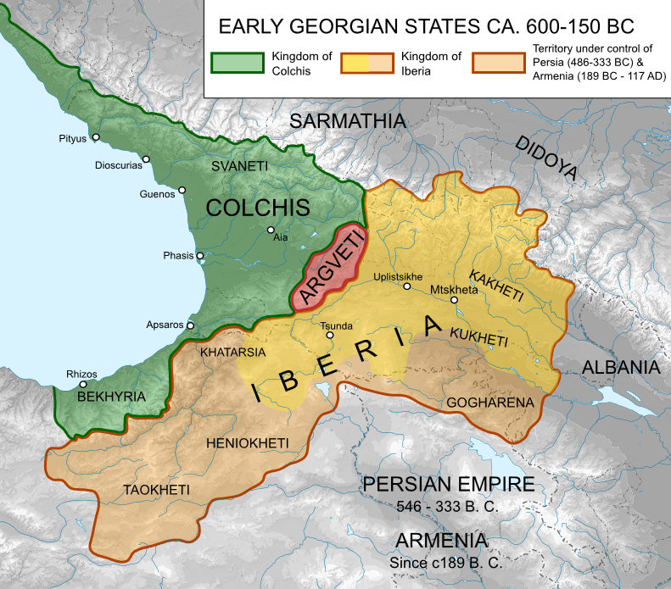
Colonization

Slide 19
Greek graffiti from Phichvnari

Slide 20
Peloponnesian war – sides
on one side –
agriculture, infantry and oligarchy
on the other –
trade, navy and democracy

Slide 21
Democracy
the term democracy originates from the Greek δημοκρατία (dēmokratía), which was coined from δῆμος (dêmos) “people” and κράτος (krátos) “power” or “rule”, and denotes the “rule of the people”.

Slide 22
Democracy
Polis as a joint-stock company, where shareholders were πολίται – citizens, was in modern sence a democratic political unit. All the citizens were more or less involved in making decisions about its affairs and the interests of individuals were more or less respected.

Slide 23
Democracy
But if the power of daily decision-making was held by an individual, or by a small number of individuals, for Greeks it was another system – monarchy or oligarchy. The term only was reserved for a system where all citizens were directly involved in governing the polis.

Slide 24
Democracy
Despite whole diversity of modern political models they are based on common principles of division of powers and representative, elective democracy. This wouldn’t be called democracy by the Greeks, but it is the only possibility of having a stable democracy outside of classical Athens.

Slide 25
Democracy
The forms of organization of the power are, of course, very important, but subordinated to the main principles of a fair society, which are common for Athenians and modern civilized mankind. And the funerary speech of Pericles, as presented by Thucydides (2.35-46) is, in my opinion, the best manifesto of democracy.

Slide 26
Steps of the Athenian Democracy
Reforms of Solon – only rich Athenians were allowed to be elected to administrative and judicial offices.
ἰσονομία – equation of rights by Clisthenes
the powerful fleet under Themistocles. This was not only decissive in the war with Persians, but also transformed the whole Athenian society: on the one hand, trade became an important branch of economy, while on the other hand, poor citizens, now able to be useful for Athens serving as rowers, gained political weight.

Slide 27
Leaders and their allies
1.19: The policy of Sparta was not to exact tribute from her allies, but merely to secure their subservience to her interests by establishing oligarchies among them; Athens, on the contrary, had by degrees deprived hers of their ships, and imposed instead contributions in money on all except Chios and Lesbos.

Slide 28
Peloponnesian war – reasons
1.23. ... The real cause, however, I consider to be the one which was formally most kept out of sight. The growth of the power of Athens, and the alarm which this inspired in Sparta, made war inevictible...

Slide 29
Peloponnesian war – results
1.23. ... The Peloponnesian war went on for a very long time and there occured during it disasters of a kind and number that no other similar period of time could match. Never had so many cities been taken and laid desolate, here by the barbarians, here by the parties contending (the old inhabitants being sometimes removed to make room for others); never was there so much banishing and bloodshedding, now on the field of battle, now in political strife...

